Slide 1

BANKING SYSTEM
SANTHOSH KUMAR

Slide 2
INTRODUCTION
Banking Database System is a structured relational database designed to manage core operations of a bank. It provides a framework for storing and retrieving information related to customers , accounts , transactions , loans , branches , and employees .
The system has been developed using SQL (Structured Query Language) and follows a normalized relational model to ensure data integrity, consistency, and efficient querying.

Slide 3
FEATURES
Branch – Stores information about bank branches including branch ID, name, and location.
Customer – Maintains personal details of bank customers such as name, date of birth, address, and contact information.
Account – Records bank accounts linked to customers and branches, including account type and balance.
Transaction – Logs all financial transactions like deposits, withdrawals, and transfers related to accounts.
Loan – Tracks loan details provided to customers, including type, amount, interest rate, and repayment status.
Employee – Manages employee data such as name, role, salary, and associated branch.

Slide 4
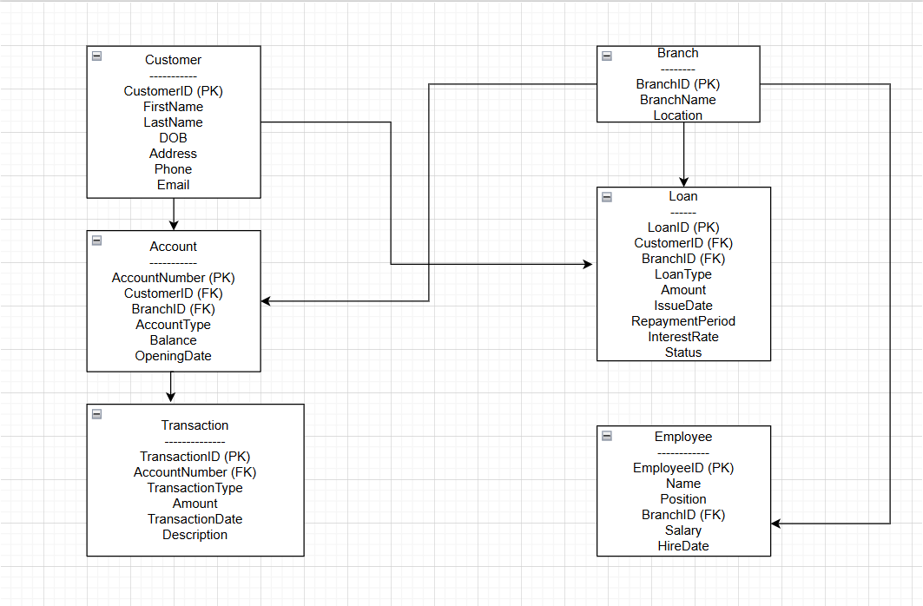
ER Diagram

Slide 5
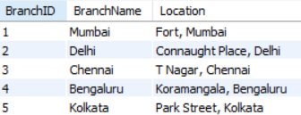
Create database banking _ system and Branch table
Create database banking_system;
Use banking_system;
CREATE TABLE Branch ( BranchID INT PRIMARY KEY,
BranchName VARCHAR(100),
Location VARCHAR(255));

Slide 6
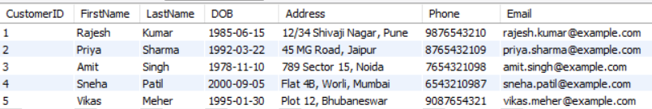
Create table of Customer
CREATE TABLE Customer ( CustomerID INT PRIMARY KEY,
FirstName VARCHAR(50),
LastName VARCHAR(50),
DOB DATE,
Address VARCHAR(255),
Phone VARCHAR(15),
Email VARCHAR(100));

Slide 7
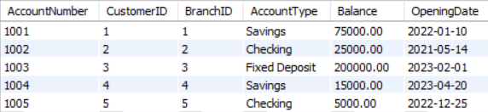
Create table of Account
CREATE TABLE Account ( AccountNumber INT PRIMARY KEY,
CustomerID INT, BranchID INT,
AccountType ENUM('Savings', 'Checking', 'Fixed Deposit') NOT NULL,
Balance DECIMAL(15,2),
OpeningDate DATE,
FOREIGN KEY (CustomerID) REFERENCES Customer(CustomerID),
FOREIGN KEY (BranchID) REFERENCES Branch(BranchID));

Slide 8
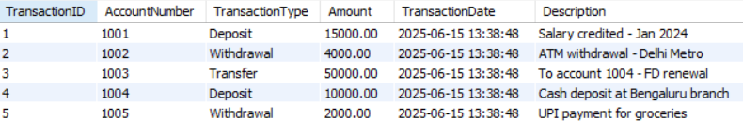
Create table of Transaction
CREATE TABLE Transaction
( TransactionID INT PRIMARY KEY,
AccountNumber INT,
TransactionType ENUM('Deposit', 'Withdrawal', 'Transfer') NOT NULL,
Amount DECIMAL(15,2),
TransactionDate DATETIME DEFAULT CURRENT_TIMESTAMP,
Description TEXT,
FOREIGN KEY (AccountNumber) REFERENCES Account(AccountNumber));

Slide 9
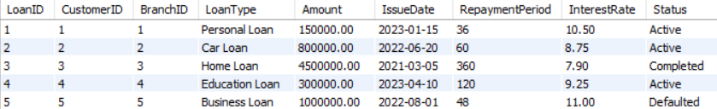
Create table of Loan
CREATE TABLE Loan
( LoanID INT PRIMARY KEY,
CustomerID INT, BranchID INT,
LoanType VARCHAR(50),
Amount DECIMAL(15,2),
IssueDate DATE,
RepaymentPeriod INT, InterestRate DECIMAL(5,2),
Status ENUM('Active', 'Completed', 'Defaulted'),
FOREIGN KEY (CustomerID) REFERENCES Customer(CustomerID),
FOREIGN KEY (BranchID) REFERENCES Branch(BranchID));

Slide 10
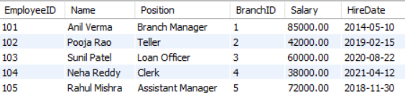
Create table of Employee
CREATE TABLE Employee ( EmployeeID INT PRIMARY KEY, Name VARCHAR(100), Position VARCHAR(50), BranchID INT, Salary DECIMAL(10,2), HireDate DATE, FOREIGN KEY (BranchID) REFERENCES Branch(BranchID));

Slide 11

High-Balance Savings Accounts
SELECT c.FirstName, c.LastName, a.Balance
FROM Account a JOIN Customer c ON a.CustomerID = c.CustomerID
WHERE a.AccountType = 'Savings' AND a.Balance > 50000;

Slide 12
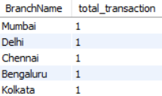
Total Transactions Per Branch
SELECT b.BranchName,
COUNT(t.TransactionID) AS TotalTransactions FROM Transaction t
JOIN Account a ON t.AccountNumber = a.AccountNumber
JOIN Branch b ON a.BranchID = b.BranchID GROUP BY b.BranchID;

Slide 13

Active Loans with Overdue Periods
SELECT c.FirstName, c.LastName, l.LoanType, l.Amount FROM Loan l
JOIN Customer c ON l.CustomerID = c.CustomerID
WHERE l.Status = 'Active' AND l.RepaymentPeriod > 60;

Slide 14

Top 3 Customers by Total Deposit Amount
SELECT c.FirstName, c.LastName, SUM(t.Amount) AS TotalDeposits FROM Transaction t
left JOIN Account a ON t.AccountNumber = a.AccountNumber
left JOIN Customer c ON a.CustomerID = c.CustomerID
WHERE t.TransactionType = 'Deposit‘
GROUP BY c.CustomerID ORDER BY TotalDeposits LIMIT 3;

Slide 15
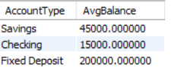
Average balance by account balance
SELECT AccountType, AVG(Balance) AS AvgBalance
FROM Account GROUP BY AccountType;

Slide 16
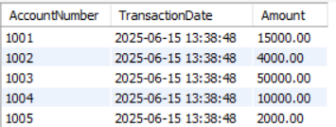
Most Recent Transaction for Each Account
SELECT t.AccountNumber, t.TransactionDate, t.Amount FROM Transaction t
JOIN ( SELECT AccountNumber, MAX(TransactionDate) AS MaxDate
FROM Transaction GROUP BY AccountNumber)
latest ON t.AccountNumber = latest.AccountNumber AND t.TransactionDate = latest.MaxDate;

Slide 17

Loans with Interest Rate Above Average
SELECT l.LoanID, l.LoanType, l.InterestRate FROM Loan l
WHERE l.InterestRate > (SELECT AVG(InterestRate) FROM Loan);

Slide 18
Loan Defaulters with Contact Info
SELECT c.FirstName, c.LastName, c.Phone, c.Email, l.LoanType FROM Loan l
JOIN Customer c ON l.CustomerID = c.CustomerID
WHERE l.Status = 'Defaulted';

Slide 19

Branch with Highest Total Loan Amount
SELECT b.BranchName, SUM(l.Amount) AS TotalLoanAmount FROM Loan l
JOIN Branch b ON l.BranchID = b.BranchID
GROUP BY b.BranchID
ORDER BY TotalLoanAmount DESC LIMIT 1;

Slide 20

Employees Earning More Than Avg Salary
SELECT Name, Position, Salary FROM Employee
WHERE Salary > ( SELECT AVG(Salary) FROM Employee);

Slide 21
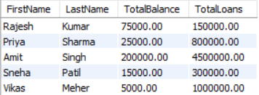
Account Balances vs Loan Amounts
SELECT c.FirstName, c.LastName,
COALESCE(SUM(a.Balance), 0) AS TotalBalance,
COALESCE(SUM(l.Amount), 0) AS TotalLoans
FROM Customer c LEFT JOIN Account a ON c.CustomerID = a.CustomerID
LEFT JOIN Loan l ON c.CustomerID = l.CustomerID
GROUP BY c.CustomerID;

Slide 22

Transactions by Weekday
SELECT DAYNAME(TransactionDate) AS Weekday,
COUNT(*) AS Transaction Count FROM Transaction
GROUP BY Weekday ORDER BY FIELD(Weekday,
'Monday','Tuesday','Wednesday','Thursday','Friday','Saturday','Sunday');

Slide 23

Conclusion
The Banking Database System is a well-structured, normalized SQL-based solution that efficiently models real-world banking operations with strong data relationships, realistic Indian data, and advanced querying capabilities, making it ideal for educational use, presentations, and further development into a full-scale banking application.

Slide 24
Thank you !

